Slide 1
Introduction to Deep Learning
By Rohan Rai
Notes:
Entered text
deep learning
Entered text
Introduction to deep learning

Slide 2
What is Deep Learning?
Deep learning is a subfield of machine learning that focuses on developing and training artificial neural networks with multiple layers. Its primary objective is to enable computers to learn and make decisions without explicit programming for each specific task.
Deep learning models are built using artificial neural networks, which are computational models inspired by the structure and functioning of the human brain. These networks consist of interconnected nodes, or artificial neurons, organized into layers. The layers allow the network to learn hierarchical representations of data.

Slide 3
Why is deep learning so powerful?
Deep learning is powerful because it has the ability to automatically learn intricate representations from raw data, enabling the modeling of complex relationships and capturing of high-level abstractions. Its hierarchical structure, combined with the scalability of big data, allows deep learning models to generalize well and make accurate predictions. With advancements in hardware and continuous research, deep learning continues to push the boundaries of what machines can achieve, making it a transformative technology in fields such as computer vision, natural language processing, and more.

Slide 4
Difference Between ML and DL
Aspect | Machine Learning | Deep Learning
Model Complexity | Relies on manual feature engineering before training. | Learns feature representations directly from raw data.
Model Complexity | Utilizes various algorithms like decision trees, support vector machines (SVMs), etc. | Relies on artificial neural networks with multiple layers.
Amount of Data | Requires a moderate to large amount of labeled data. | Benefits from large-scale datasets and extensive labeled data.
Training and Computation | Training involves optimizing model parameters using algorithms like gradient descent, SVM, etc. | Training deep neural networks is computationally intensive and requires powerful hardware resources.
Application Examples | Traditional statistical modeling, decision trees, random forests, SVM, etc. | Computer vision, natural language processing, speech recognition, etc.

Slide 5
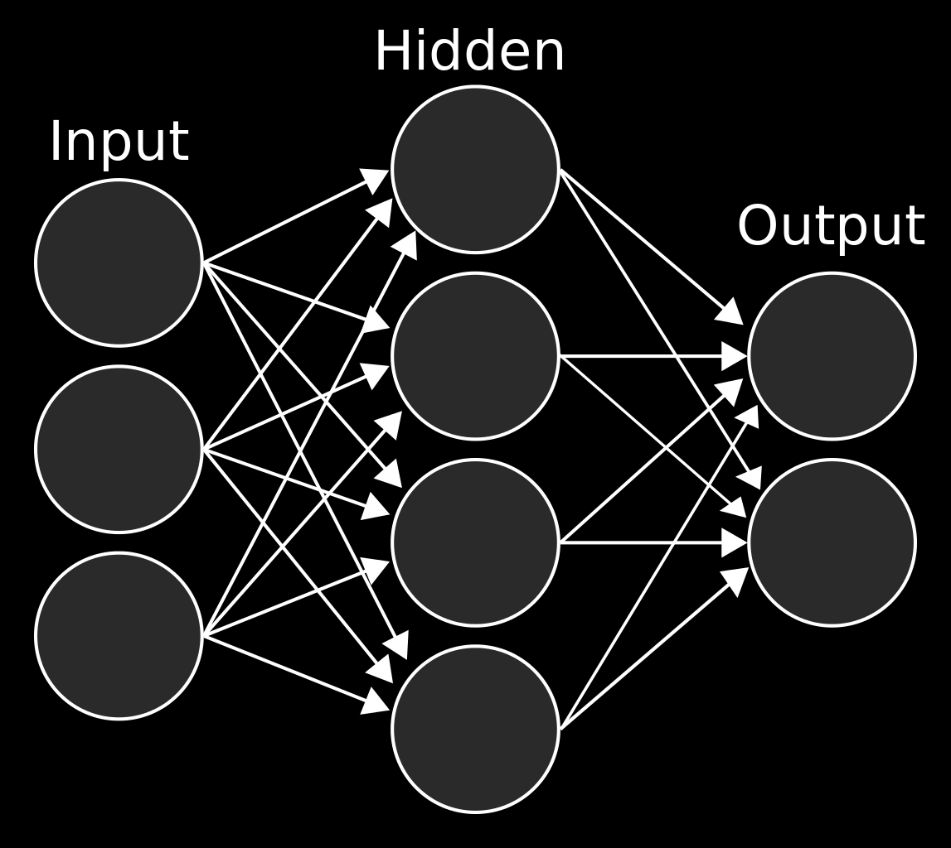
Layers in Neural Network
There can be as many layers in a Neural Network as required.But there are main 3 types of layers in a neural network
Input Layer
Hidden Layer
Output Layer

Slide 6
Input Layer
The input layer is the first layer of the neural network and is responsible for receiving the raw input data. It consists of neurons, with each neuron representing a feature or attribute of the input data. The number of neurons in the input layer is determined by the dimensionality of the input data, where each neuron receives and passes along a specific input feature. The input layer does not perform any computations or transformations on the data; its purpose is solely to pass the input to the subsequent layers for further processing.

Slide 7
Hidden Layers
Hidden layers are intermediate layers between the input and output layers of a neural network. They play a crucial role in learning complex patterns and representations from the input data. Each neuron in a hidden layer receives inputs from the neurons in the previous layer and performs computations using weighted connections and an activation function.
Weighted Connections: Each connection between neurons in adjacent layers has an associated weight. These weights determine the strength and importance of the information flowing through the connections.
Activation Function: Each neuron in a hidden layer applies an activation function to the weighted sum of its inputs, introducing non-linearity into the network.Non-linear activation functions enable the network to learn and represent complex relationships in the data.

Slide 8
Output Layer
The output layer is the final layer of the neural network and produces the network's predictions or outputs based on the information learned in the hidden layers. The number of neurons in the output layer depends on the task being performed. For example, in binary classification, there might be one neuron representing the probability of the positive class, while in multi-class classification, each neuron could represent the probability of a specific class.
By combining the input layer, hidden layers, and output layer, a neural network can process and learn from input data to make predictions or perform other tasks. The connections between layers, the weights associated with those connections, and the activation functions applied at each neuron collectively allow the network to model complex relationships and capture meaningful representations from the input data.

Slide 9
Types of Deep Learning Models
There are some types of deep learning models commonly used in various applications:
Convolutional Neural Networks (CNNs) It is mostly used in image classification, object detection, and image segmentation tasks
Recurrent Neural Networks (RNNs) It is mostly used in speech recognition, machine translation, sentiment analysis, and text generation.
Generative Adversarial Networks (GANs) It is mostly used in generating realistic images, creating synthetic music, and even generating text

Slide 10
Convolutional Neural Networks (CNNs)
Convolutional Neural Networks, or CNNs, are widely used in computer vision tasks. They are designed to process grid-like data, such as images. CNNs utilize convolutional layers, pooling layers, and fully connected layers.
The convolutional layers extract features hierarchically by applying filters to local receptive fields, capturing spatial patterns. Pooling layers reduce the spatial dimensions, retaining essential information.

Slide 11
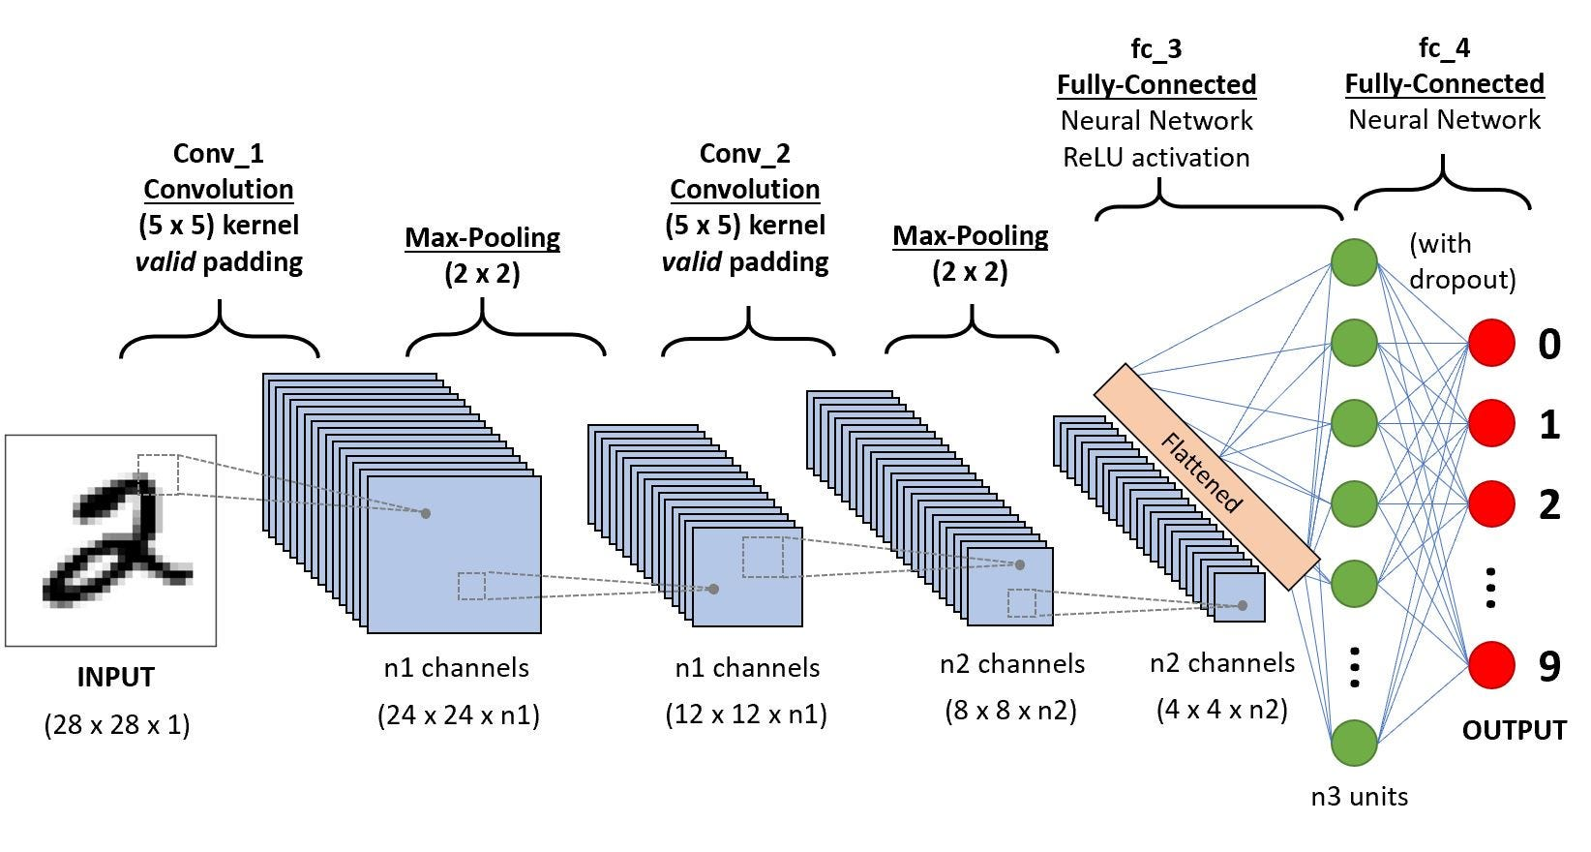

Slide 12
Recurrent Neural Networks (RNNs)
Recurrent Neural Networks, or RNNs, are designed for sequential data processing tasks. They are well-suited for handling sequences of varying lengths. RNNs have a feedback loop that allows information to persist across time steps, enabling them to model temporal dependencies.
However, traditional RNNs suffer from the vanishing gradient problem. Variants like Long Short-Term Memory (LSTM) and Gated Recurrent Unit (GRU) address this issue quite well.

Slide 13
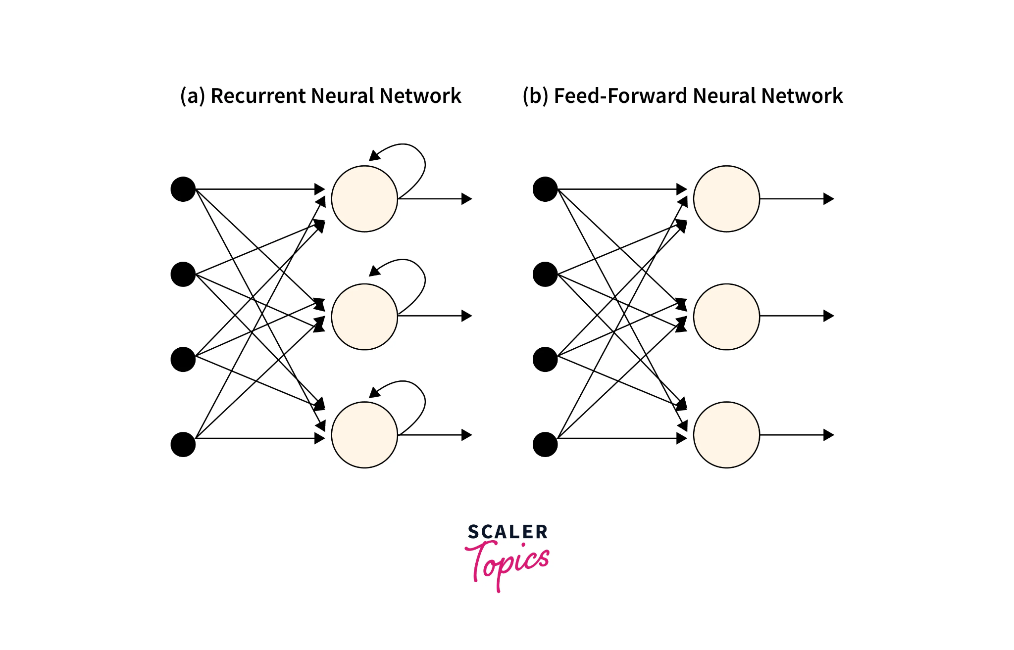
Feedback
Inputs
Outputs

Slide 14
Generative Adversarial Networks (GANs)
Generative Adversarial Networks, or GANs, consist of a generator and a discriminator network that are trained simultaneously. GANs are used for generative modeling tasks, aiming to generate synthetic data that resembles the real data distribution.
The generator network learns to generate realistic samples, while the discriminator network learns to distinguish between real and generated samples.

Slide 15
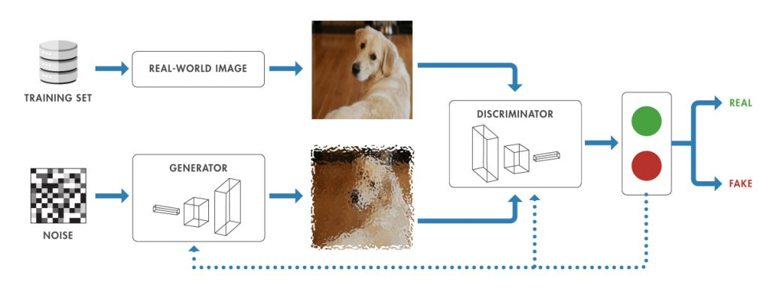

Slide 16


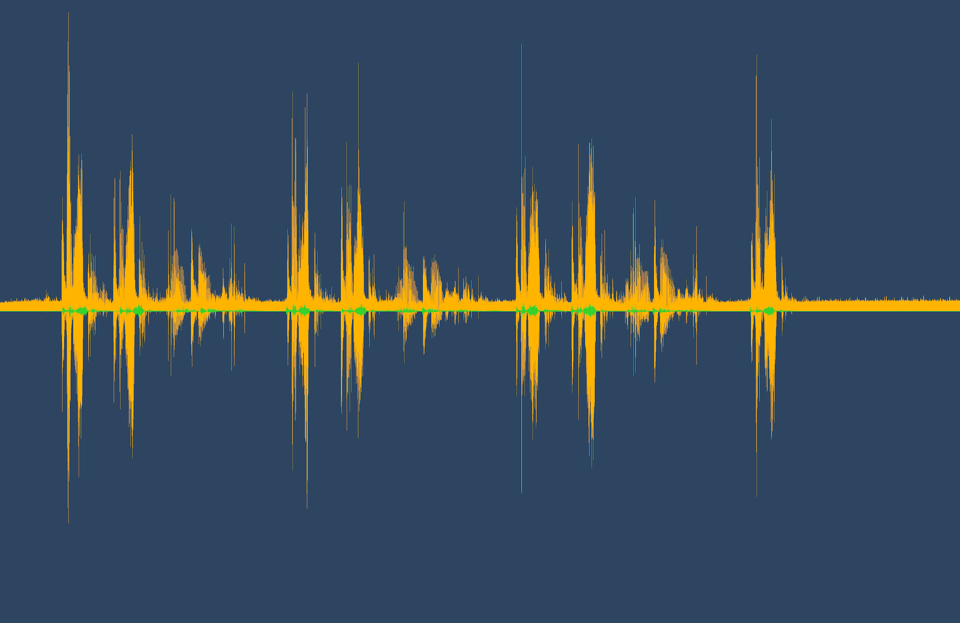

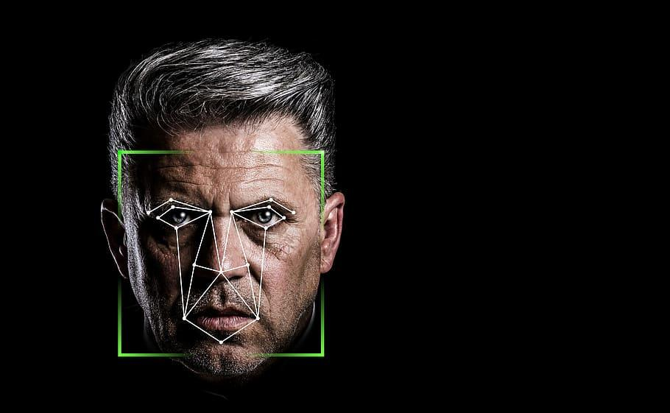

Applications of Deep Learning

Slide 17
Conclusion
Deep learning represents a powerful and promising approach in machine learning, enabling machines to learn complex patterns, make accurate predictions, and solve intricate problems.
As deep learning continues to evolve, we can expect even more exciting breakthroughs and applications, pushing the boundaries of what machines can achieve.

Slide 18
Thank you so much.

